Slide 1
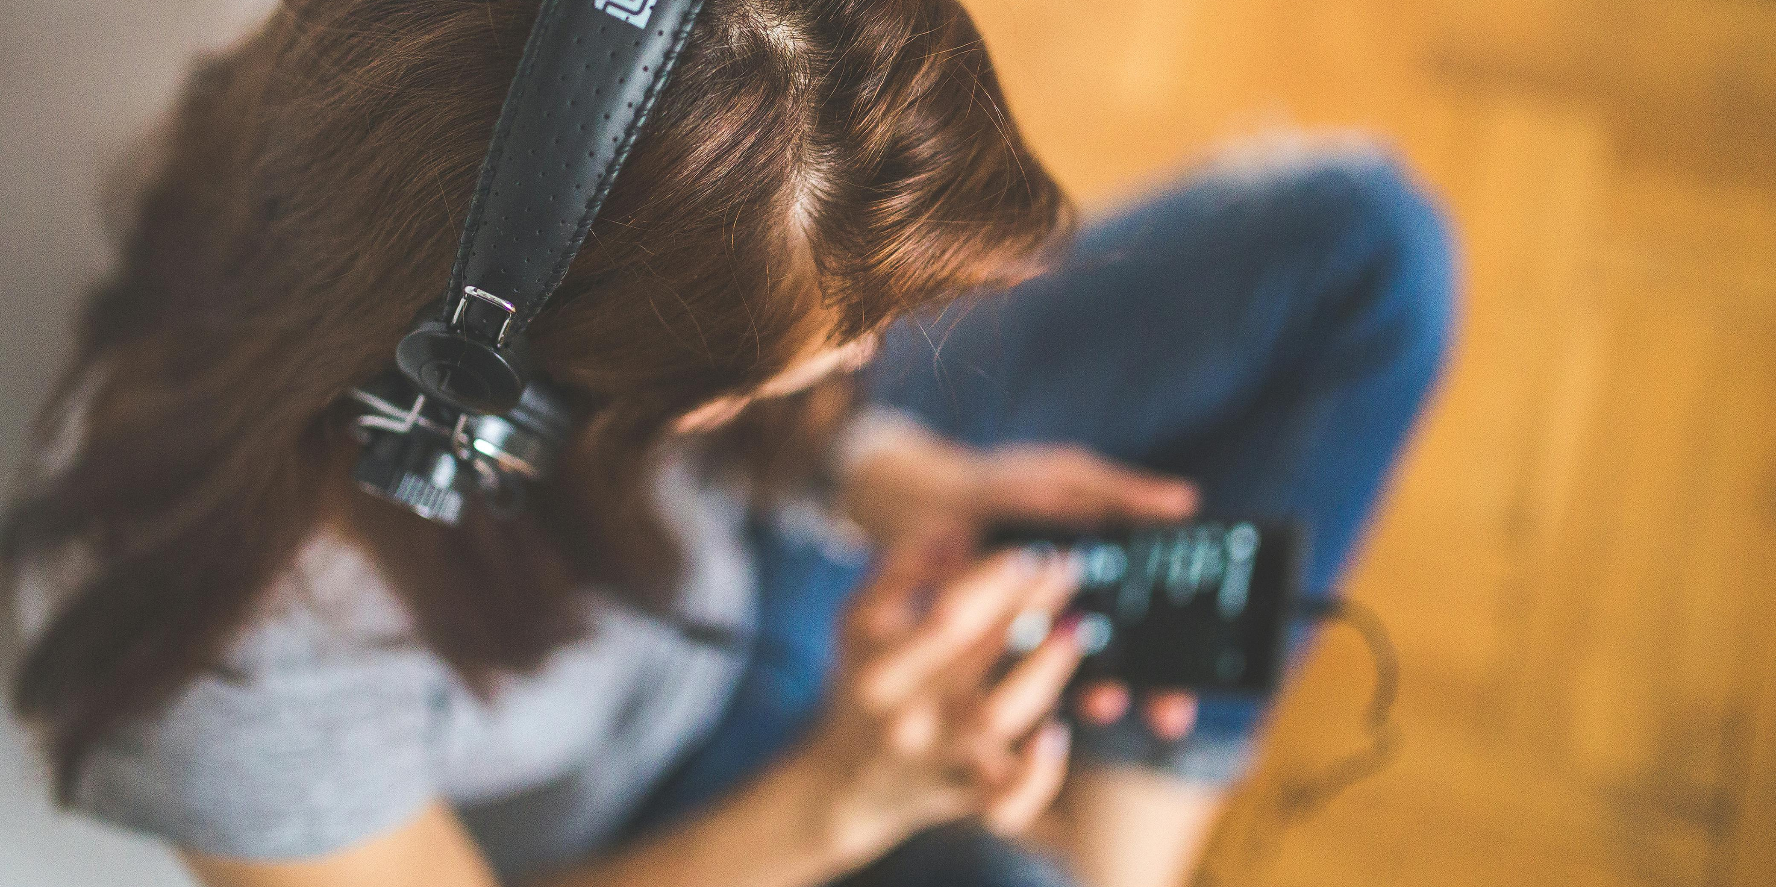
Have music listening habits changed over the last 6 years?

Slide 2

Project aim
In this project we aim to understand whether music listening habits have changed in the last 6 years.
Two main reasons lead us to believe this might be the case:
The global COVID pandemic;
The rise of social network Tik-Tok

Slide 3
Research Questions
1. Have the genres people listen to changed?
2. Have the artists people listen to changed?
3. Is the duration of the most popular songs decreasing?
4. How have other track features changed?

Slide 4
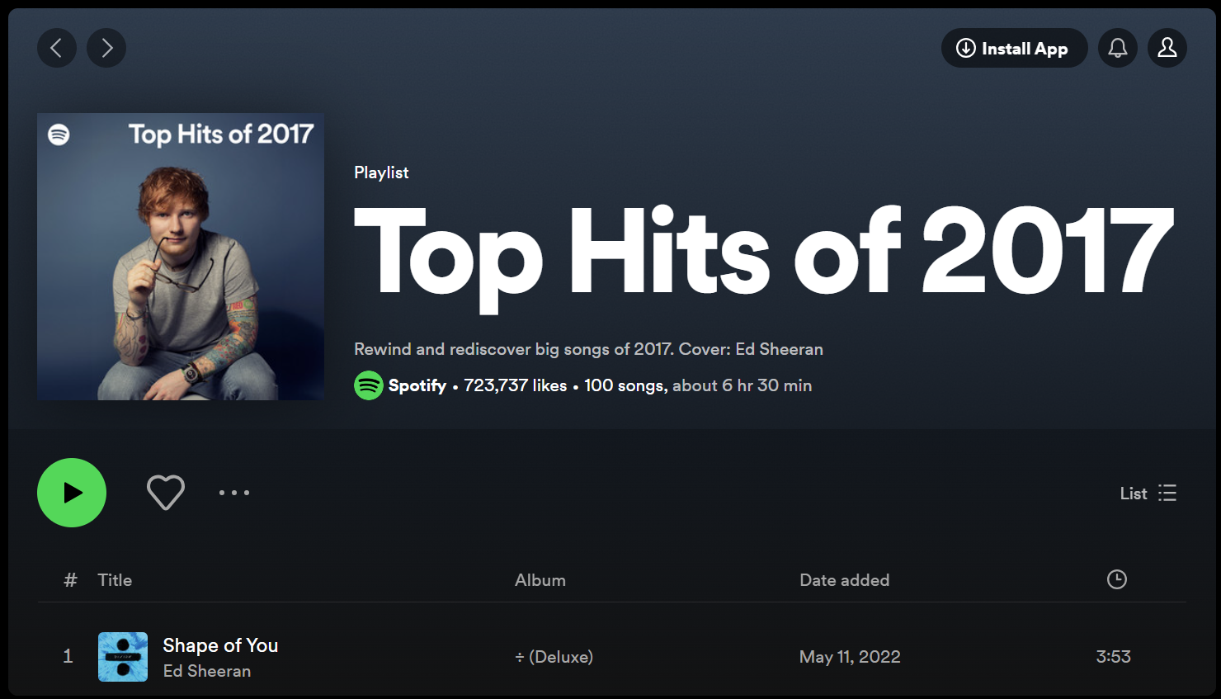
Data collection
We selected 6 playlists, spanning from 2017 to 2022 and used the Spotipy API to request the details of all the songs in these playlists, including:
Track id
Track name
Track popularity
Track features
Artist id
Artist name
Artist genre
Every year, Spotify posts a playlist of their top 100 most streamed songs.

Slide 5
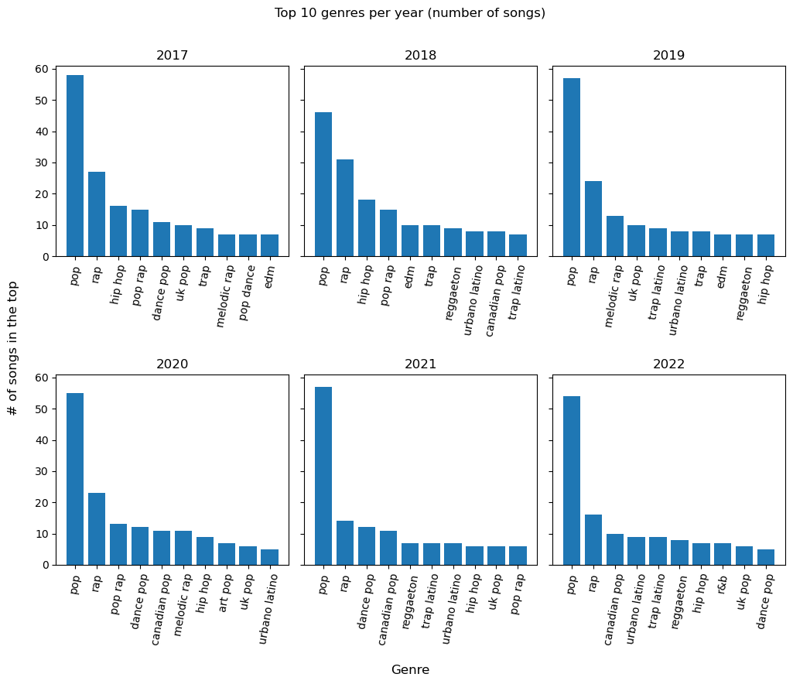
1. Have the genres people listen to changed?
TOP 10 GENRES
(NUMBER OF SONGS IN TOP 100)
Whilst some genres have stayed consistently in the top 10 (e.g., pop and rap), others fluctuate significantly throughout the 6 years

Slide 6
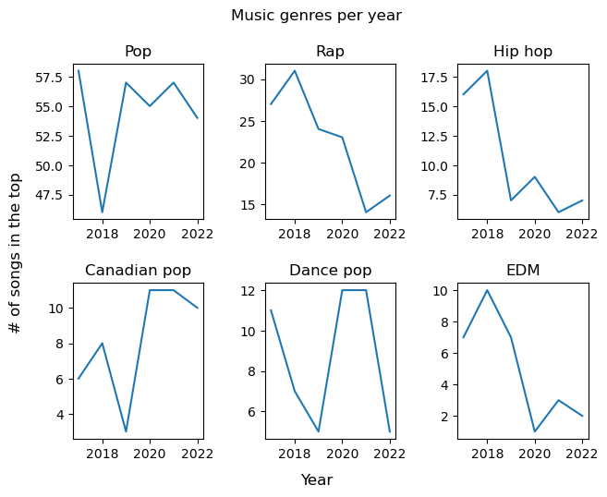
1. Have the genres people listen to changed?
TOP 10 GENRES
(NUMBER OF SONGS IN TOP 100)
Whilst some genres have stayed consistently in the top 10 (e.g., pop and rap), others fluctuate significantly throughout the 6 years

Slide 7
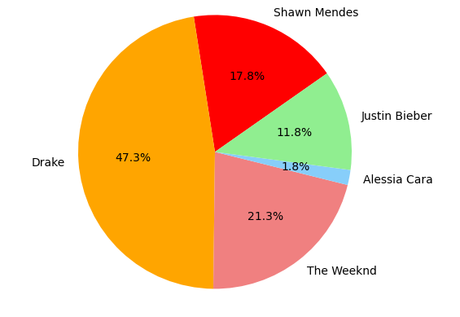
1. Have the genres people listen to changed?
DANCE POP
CANADIAN POP
Camila Cabello | Bebe Rexha
Sean Paul | Lady Gaga
Dua Lipa | Doja Cat
Avicii | Joel Corry
P!nk | Black Eyed Peas
Calvin Harris | Shakira
Jason Derulo | David Guetta
DJ Snake

Slide 8
2. Have the artists people listen to changed?
Are there Artists that have managed to be in the top 100 multiple times ?
Year | Average Song Count
2017 | 1.3
2018 | 1.3
2019 | 1.4
2020 | 1.4
2021 | 1.6
2022 | 1.5

Slide 9
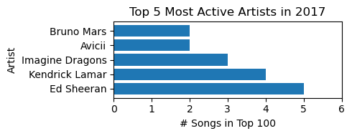
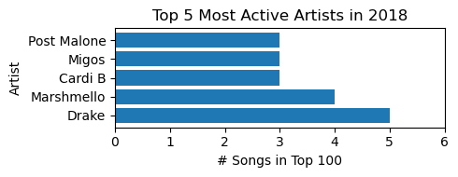
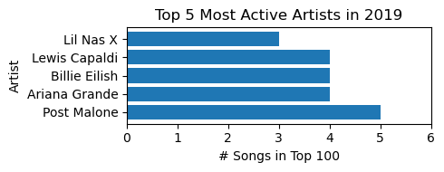
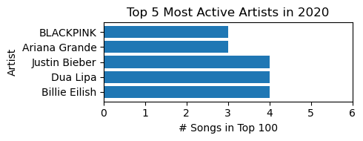
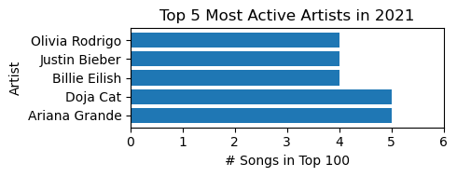
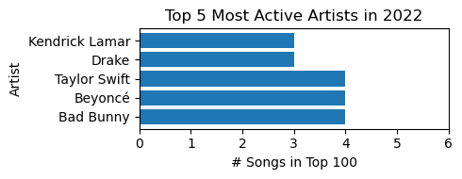
2. Have the artists people listen to changed?
Are there any artists that have been in the top 100 throughout the sampled years?

Slide 10
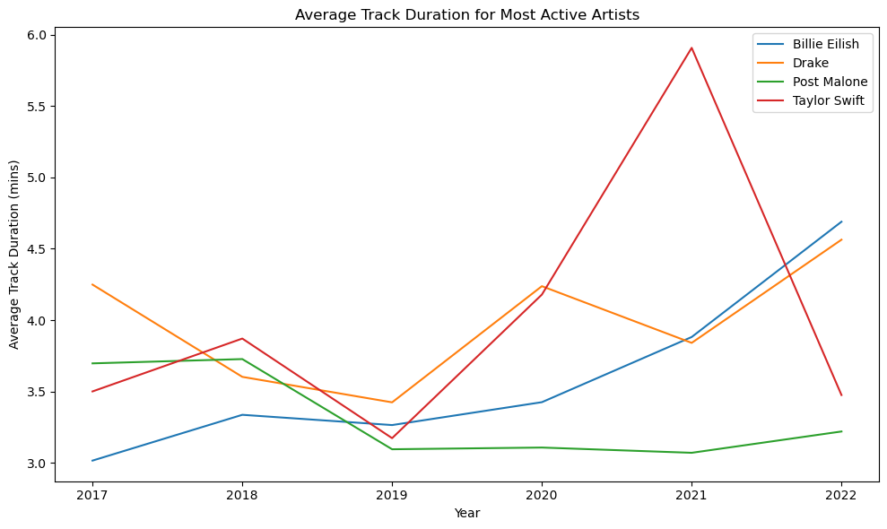
2. Have the artists people listen to changed?
Who were the consistent artists with multiple hits?
Only 5 Artists had a song in the top 100 in every year.
One of the artists didn’t appear in the top 5 with more than one top 100 song in a single year in this sampled period (Shawn Mendes)
There is a noticeable dip in all artists average song duration in 2019

Slide 11
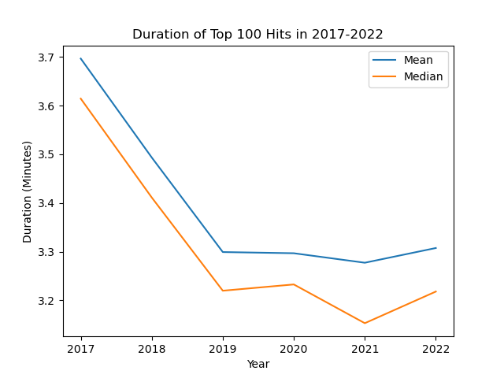
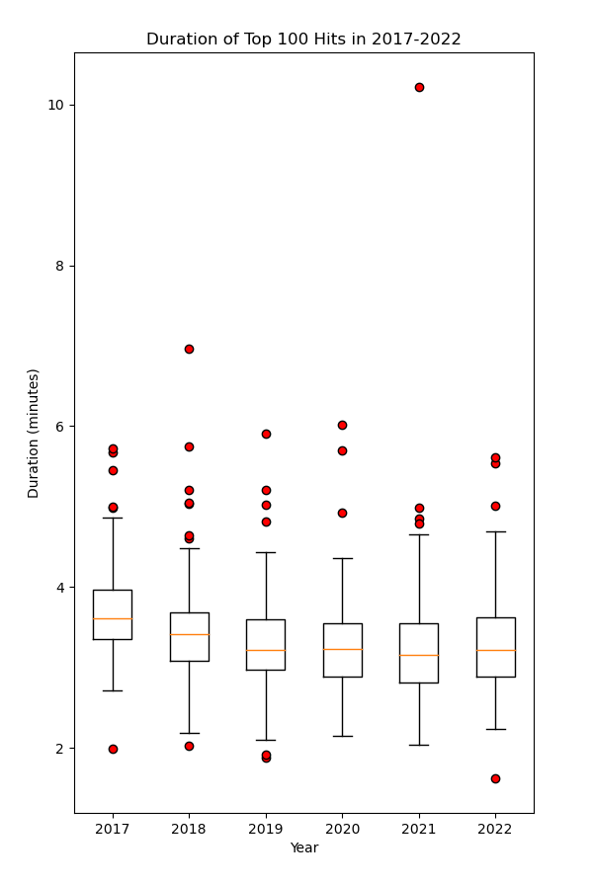
3. Is the duration of the most popular songs decreasing?
Short answer: YES!
How do we know?
Line plot & Boxplot
BOTH mean duration and median duration decreased
There are songs with a variety of durations,
but this does not affect the overall results

Slide 12
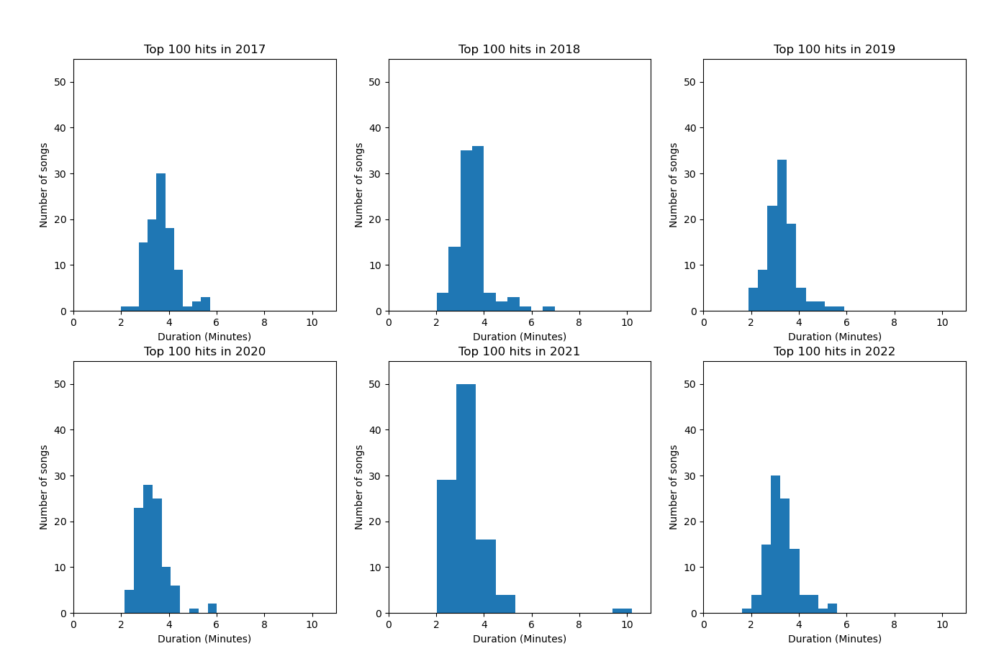
3. Is the duration of the most popular songs decreasing?
Short answer: YES!
How do we know?
Histogram
Shifted left over the years
More shorter songs in 2022 than in 2017

Slide 13
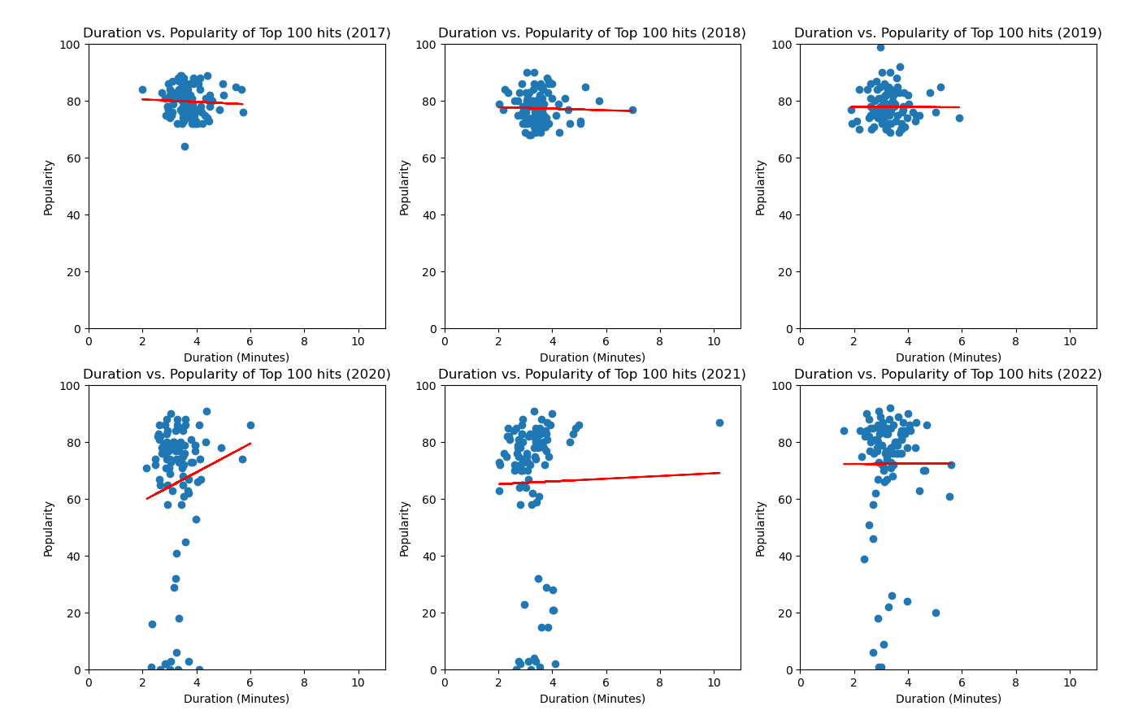
3. Is the duration of the most popular songs decreasing?
Are shorter songs more popular?
Scatter plot –
Duration Vs. Popularity
-0.06 < R-value < 0.15

Slide 14
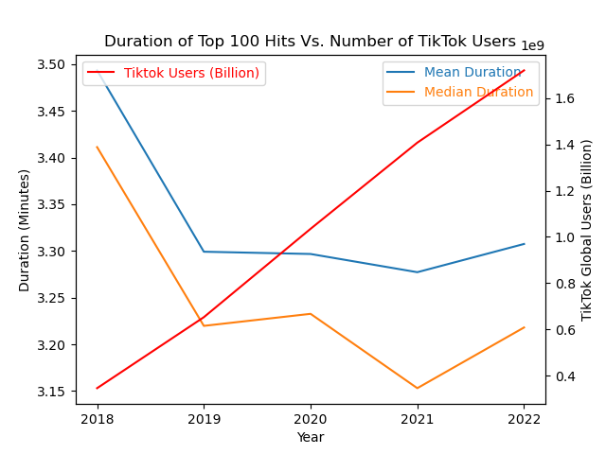
3. Is the duration of the most popular songs decreasing?
Duration Vs. TikTok users
R-value ~ - 0.7
Did the rise of TikTok contribute to the changes in music duration?

Slide 15
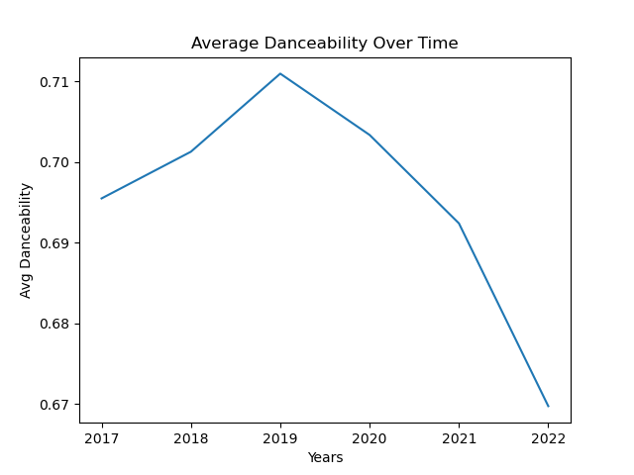
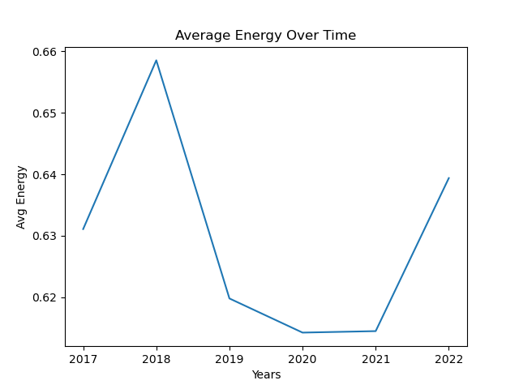
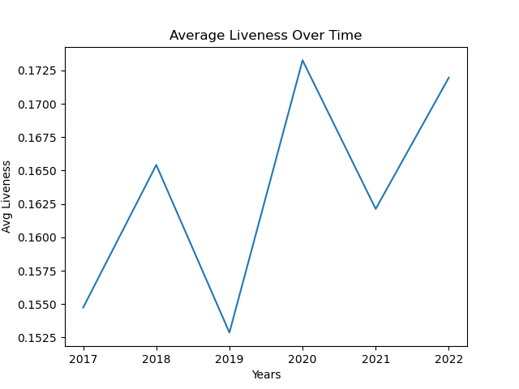
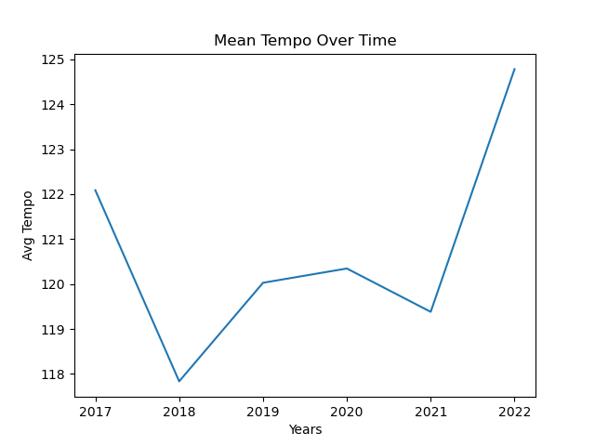
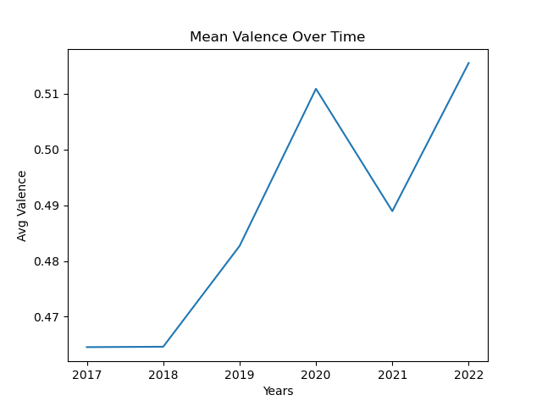
4. How have other track features changed?
Track features vary across the 6 years, with general down trajectories for danceability and energy. It is interesting to note a peak in valence in 2020 (people listened to more positive songs)

Slide 16
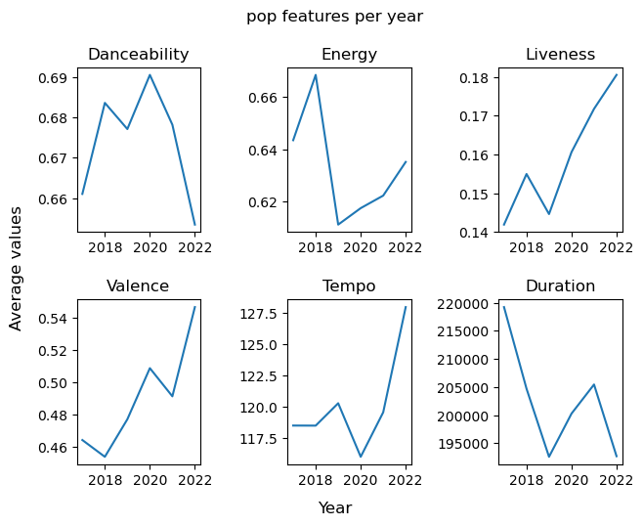
4. How have other track features changed?
Do these trends show up in specific genres?
Pop: downwards trend for danceability and energy, peak in valence in 2020

Slide 17
4. How have other track features changed?
Do these trends show up in specific genres?
Pop: downwards trend for danceability and energy, peak in valence in 2020
But… similar trends for other genres

Slide 18
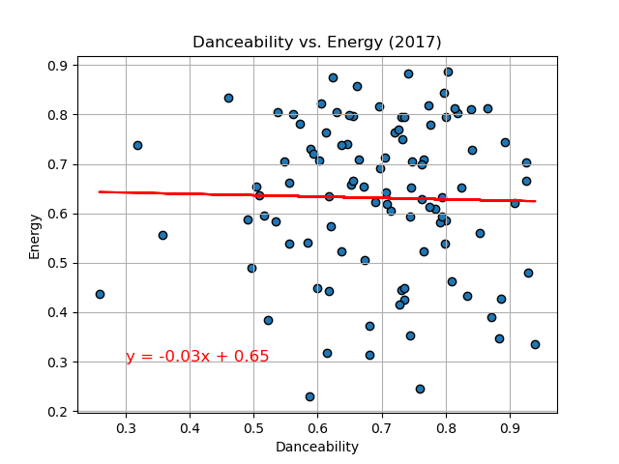
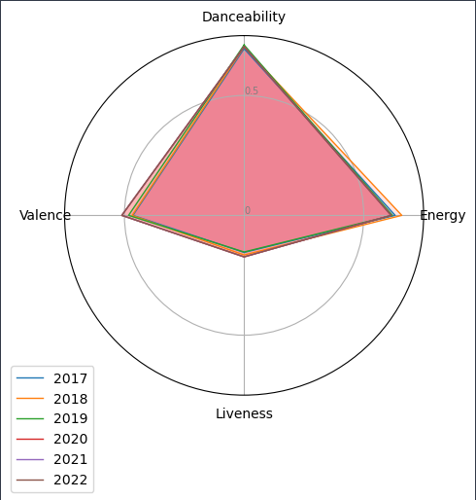
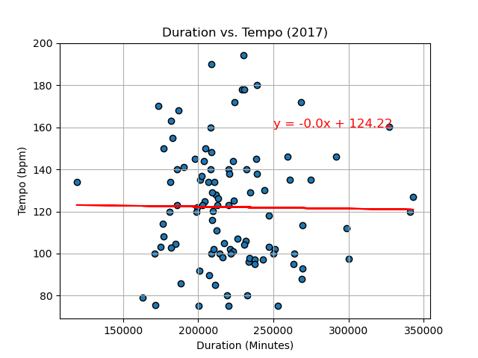
4. How have other track features changed?
Are track features related to one another?
No correlation between danceability and energy
(which one might assume would be correlated)
No correlation between tempo and duration either

Slide 19
Bonus analyses – the impact of covid
The most obvious lens to examine the scope of the coronavirus’ impact on music is through sales: the numbers measuring our consumption of music.
Following the beginning of the pandemic, physical sales — representing 25% of recorded music revenue — have fallen by about one-third, while digital sales have fallen 11%.
So how did popular artists fare?

Slide 20
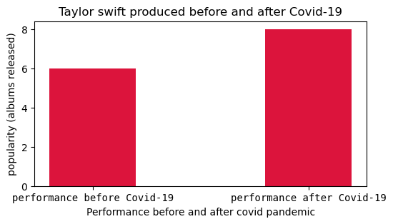
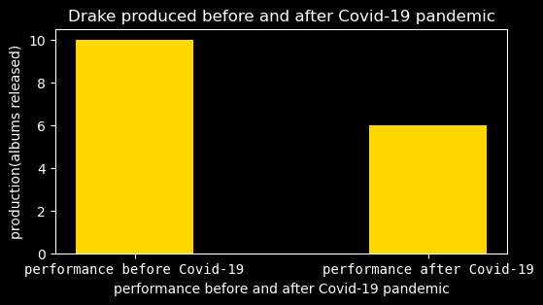
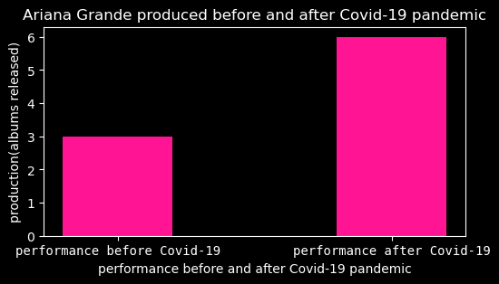
Bonus analyses – impact of covid

Slide 21
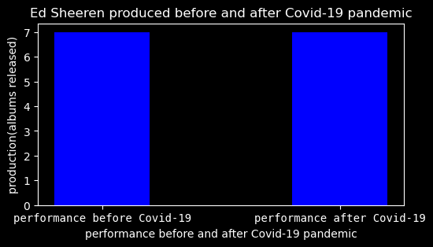
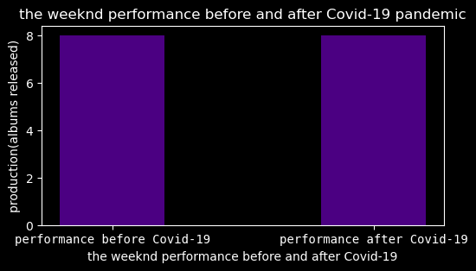
Bonus analyses – impact of covid

Slide 22
Conclusions
As we hypothesized, music habits have changed in the past 6 years:
Whilst pop and rap consistently occupy the first two positions at the top of the most listened-to genres, a lot of sub-genres of pop have risen around the period of COVID-19;
Only 5 artists had a song in the top 100 in every year, indicating people’s preferences change on a yearly base;
Songs are getting shorter in general. Song duration correlates strongly with the number of Tik-Tok users;
There has been a downward trend for features such as danceability and energy, but the songs people listen to are becoming more positive.

Slide 23
Limitations
We only collected data for the most popular songs each year. These songs are likely to naturally share features, limiting our conclusions.
We only analyzed data for the past 6 years, whereas a lot of these trends might have been occurring for much longer, as some articles suggest.
We chose to analyze the year a song was popular, not when it was released. Looking at songs' release dates might have shown a different picture altogether.

Slide 24
Any Questions?
Project team:
Catarina Ferreira
Daniel Hughes
Bernard Tse
Tafadzwa Fararira
Kehlani Jaan Khan

